Slide 1

Predictive Maintenance for Hydraulic Systems Using Machine Learning
Rock Deng University of Colorado boulder

Slide 2

PROJECT OVERVIEW
Objective: Develop a machine learning model to predict hydraulic system failures using sensor data.
Key Focus: Real-time deployment feasibility and high accuracy and computational efficiency.
Visual: Flowchart showing the project pipeline (data → preprocessing → modeling → evaluation).

Slide 3
PROBLEM STATEMENT
Current Challenges:
Reactive maintenance leads to costly downtime
Manual inspections are time-consuming
Unexpected failures disrupt operations

Slide 4
RELATED WORK
Prior Research:
Machine learning models (Random Forests, SVMs, LSTMs) for failure prediction
Feature engineering techniques (PCA, time-series analysis)

Slide 5
RELATED WORK
Gaps in Research:
Need for interpretable and lightweight models.
Limited real-time deployment applications.

Slide 6
PROPOSAL WORK
Proposed Solution:
Predictive maintenance using machine learning.
Real-time monitoring and failure prediction.

Slide 7
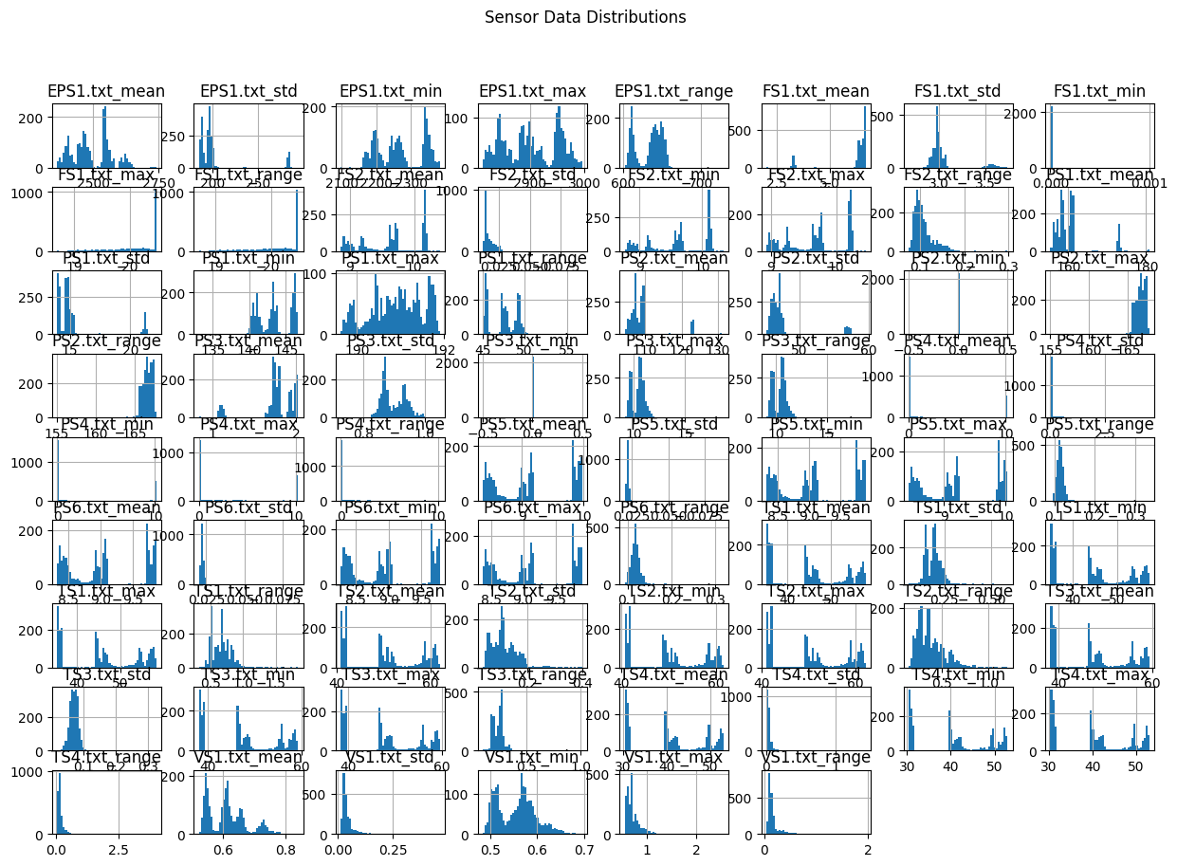
DATA PREPROCESSING
Feature Engineering
Extracted statistical features for each sensor per cycle, includes

Slide 8
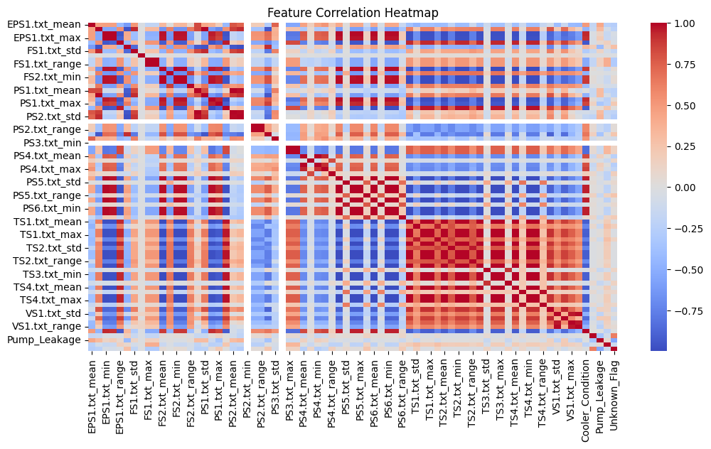
DATA PREPROCESSING
Feature Engineering Find correlation between features

Slide 9
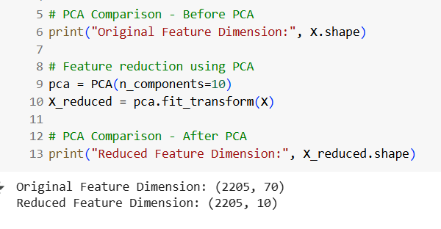
DATA PREPROCESSING
Feature reduction using PCA
Use Principal Component Analysis (PCA) to reduce the number of input features to speed up model training and model size.

Slide 10
Model Training and Evaluation
Random Forest Classifier
Random Forest, an ensemble learning method, trained using 80% of the dataset and evaluated on the remaining20%.

Slide 11
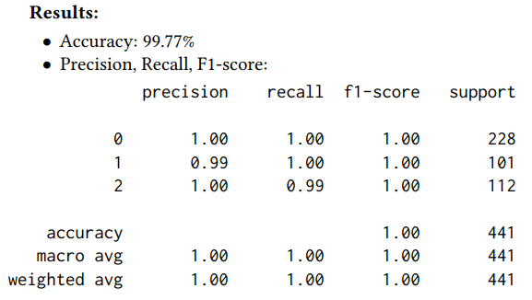
Model Training and Evaluation
Random Forest Classifier

Slide 12
Model Training and Evaluation
Classification Metrics:
Accuracy, Precision, Recall, F1-score. But we only use accuracy for this project.
Model Efficiency:
Training time and inference speed. This could be future work

Slide 13
Model Training and Evaluation
XGBoost Classifier
XGBoost, a gradient boosting algorithm, was used to compare against the Random Forest model. XGBoost is known for handling complex relationships in data efficiently.

Slide 14
PROJECT TIMELINE
Week 1: Dataset exploration and preprocessing.
Week 2-3: Implement baseline models (Decision Trees, XGBoost).
Week 4: Experiment with time-series models (LSTM, ARIMA).
Week 5: Evaluation and performance comparison.- Week 6: Final report writing and refinements.

Slide 15
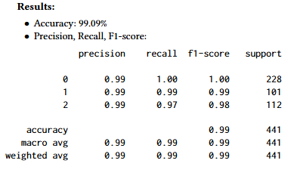
Model Training and Evaluation
XGBoost Classifier Result:

Slide 16
Model Training and Evaluation
The results show that the Random Forest model performedslightly better in accuracy compared to XGBoost. Both models achieved near-perfect performance, indicating that the extracted features effectively captured the failure patterns in the dataset.

Slide 17
Discussion
This study demonstrates that machine learning-based predictive maintenance can achieve near-perfect accuracy when applied to hydraulic system monitoring. Compared to previous research, our findings highlight the benefits of PCA in reducing computational overhead while maintaining predictive performance. Additionally, our comparative model analysis suggests that Random Forest offers a balance of interpretability and high accuracy, making it a strong candidate for real-time deployment.

Slide 18
Future work
Extending this analysis to additional predictive models, such as deep learning-based architectures for time-series forecasting.
Implementing real-time deployment strategies by optimizing model inference speed through quantization techniques.
Exploring domain adaptation techniques to generalize the model to different hydraulic systems beyond the dataset used.

Slide 19
Conclusion
This project developed a predictive maintenance system for hydraulic systems using machine learning. By leveraging sensor data and feature engineering, the system successfully predicted failures with high accuracy while optimizing computational efficiency. Future work will aim to further refine deployment strategies for real-time industrial applications.

Slide 20
THANKS！

